Slide 1
What is FIRST ?
For Inspiration and Recognition of Science and Technology
FLL Explore – Grades 2-4
FLL Challenge – Grades 4-8
FRC – Grades 9-12
EXPLORE
CHALLENGE

Slide 2
What is FIRST LEGO League Explore?
6 children per team
Grades 2-4
Met once a week for about 8 weeks
Learned about a science topic (energy/power)
Built a LEGO model (“Superpowered”)
Present their work - model, topic & team

Slide 3
Core Values
Core Values
Discovery – Explore new skills and ideas.
Innovation – Use creativity and persistence to solve problems.
Impact – Apply our ideas to improve our world.
Inclusion – Respect each other and embrace our differences.
Teamwork – We are stronger when we work together.
Fun – Enjoy and celebrate what we do!

Slide 4
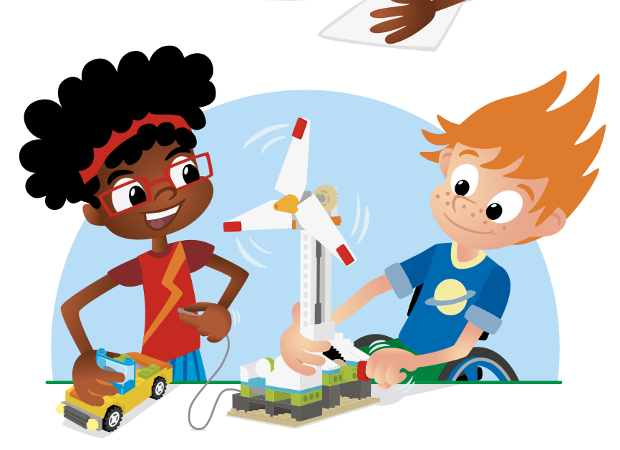
Each Year a New Challenge Topic
Imagine and innovate new ways to create and communicate art across the globe.
Create a team model showing the ideas of the team.
Incorporate and program LEGO using the “WeDo” OR “Spike” software
Create a Show Me poster

Slide 5
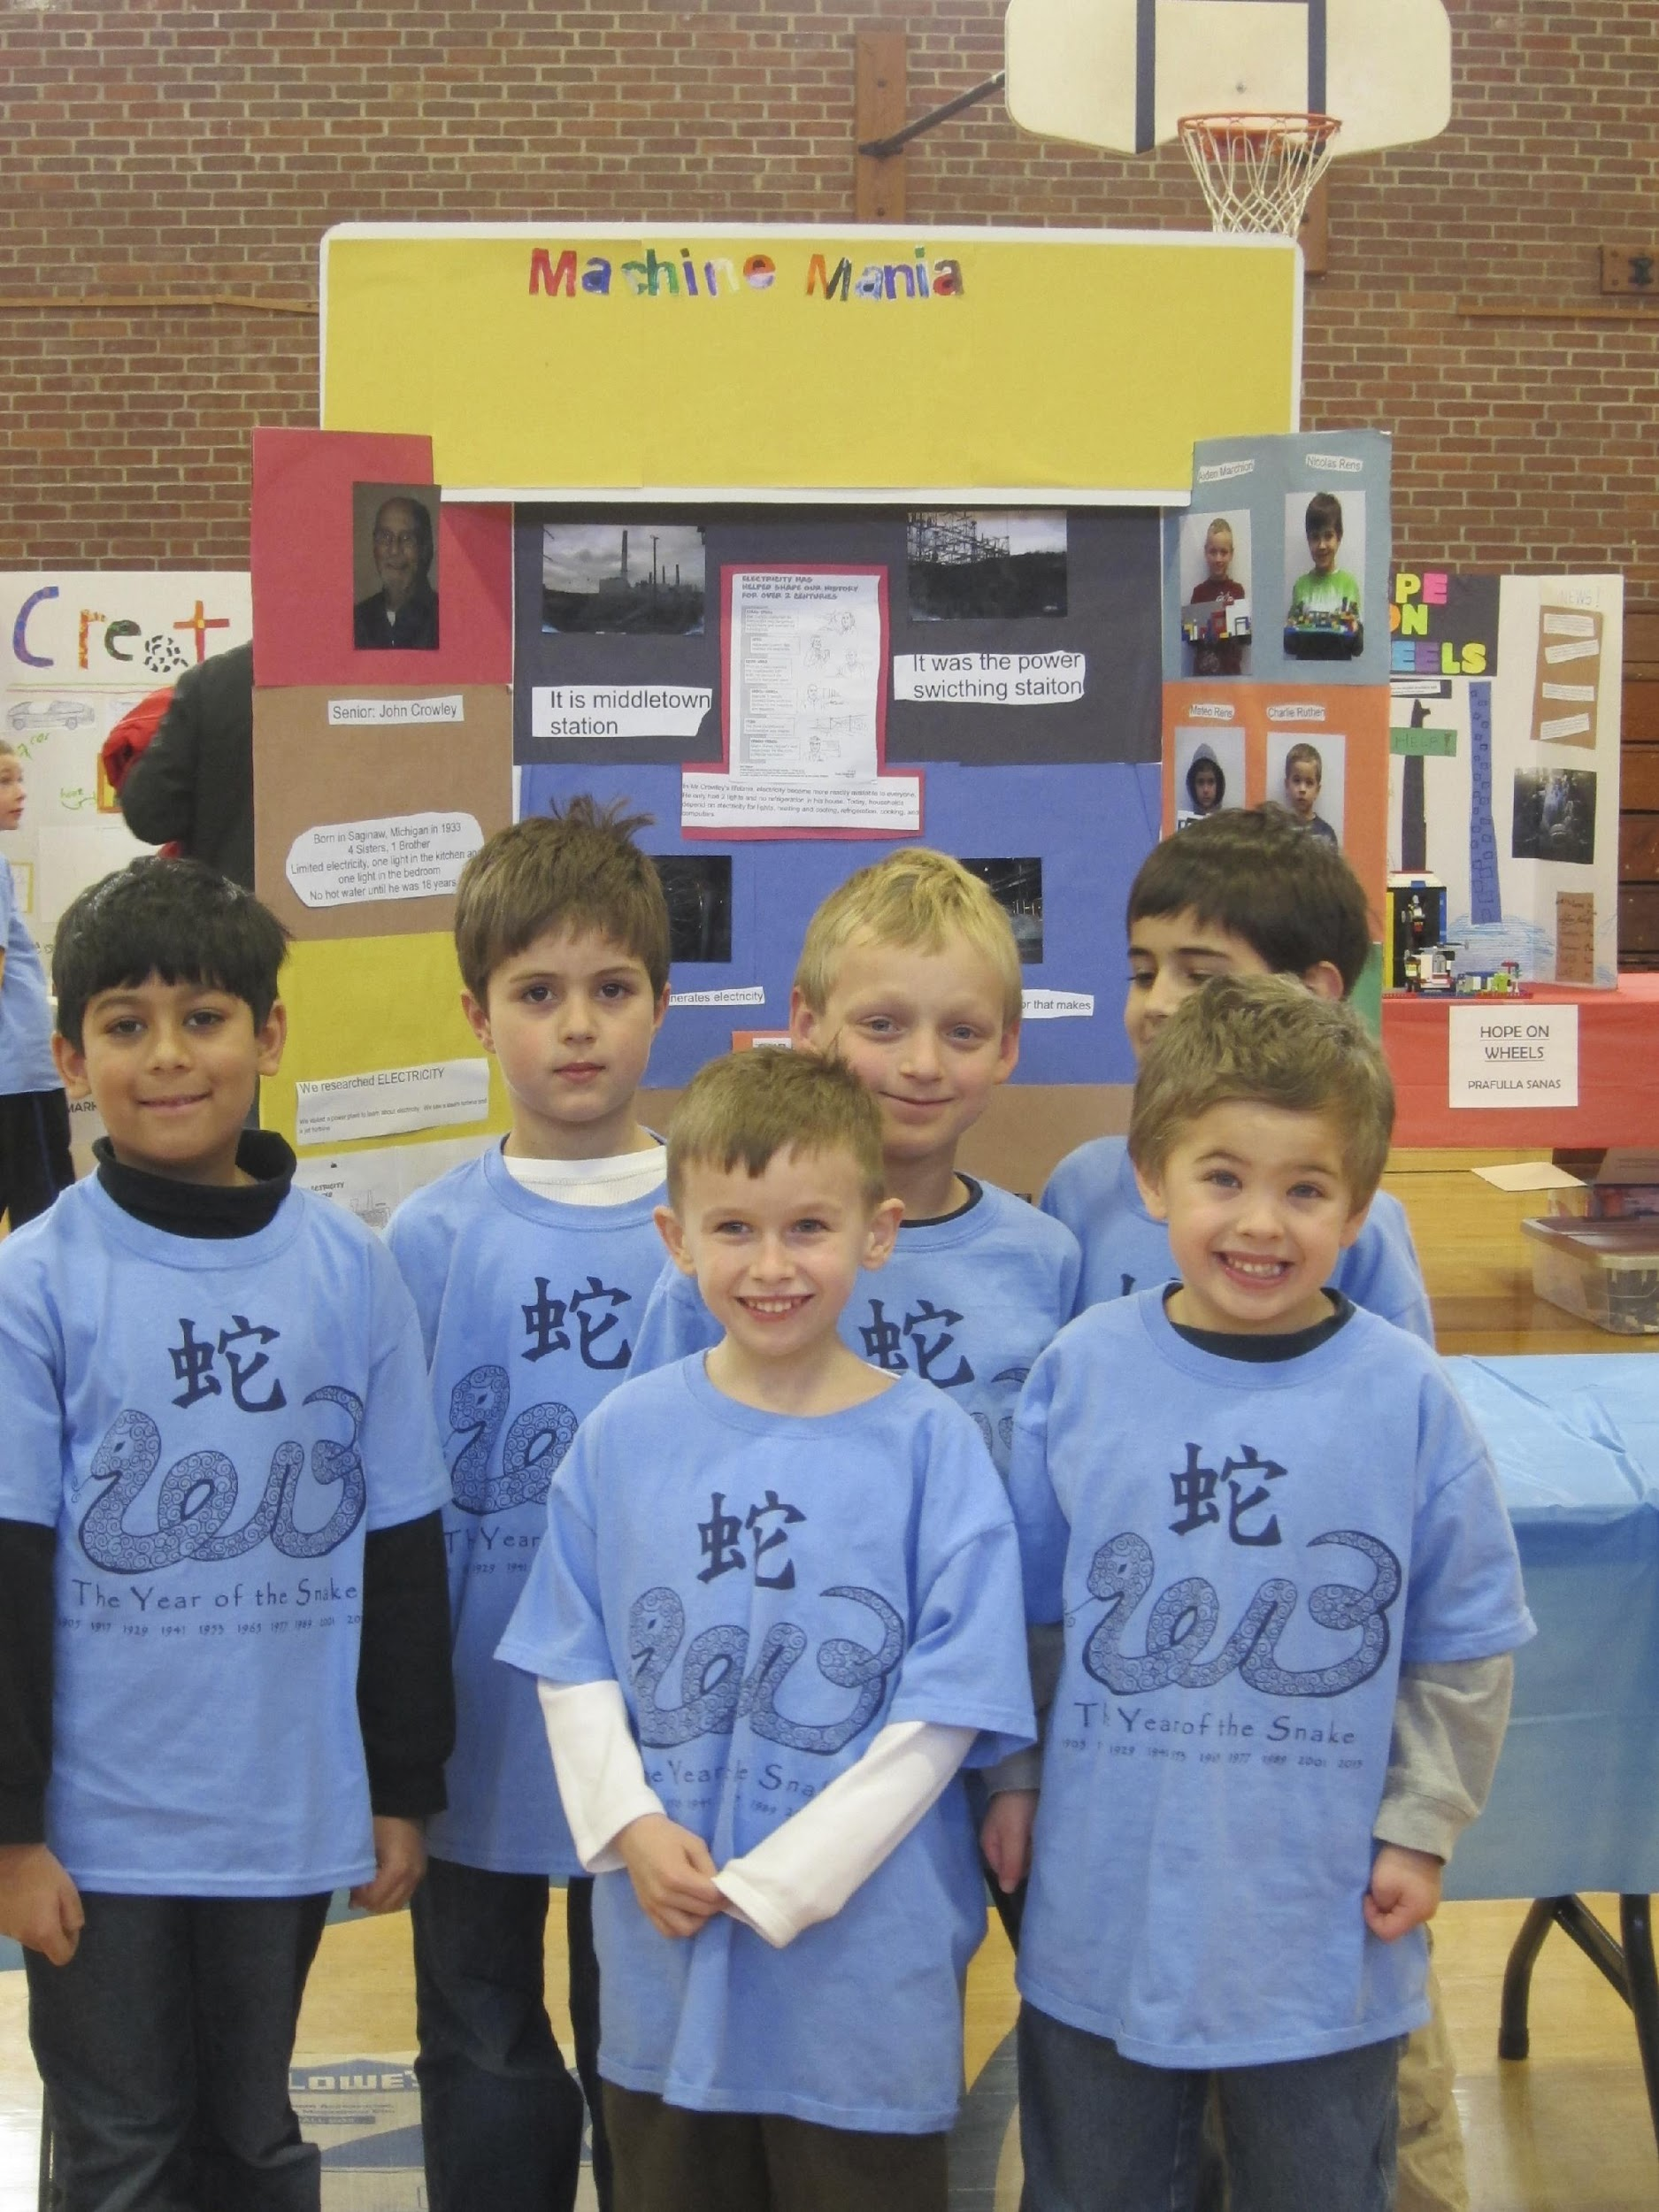
At a FIRST LEGO League Explore Expo…
Teams share:
Their experiences learning about the topic;
What they learned working as a member of a team;
Their satisfaction of becoming an “expert” and teaching others (YOU).

Slide 6
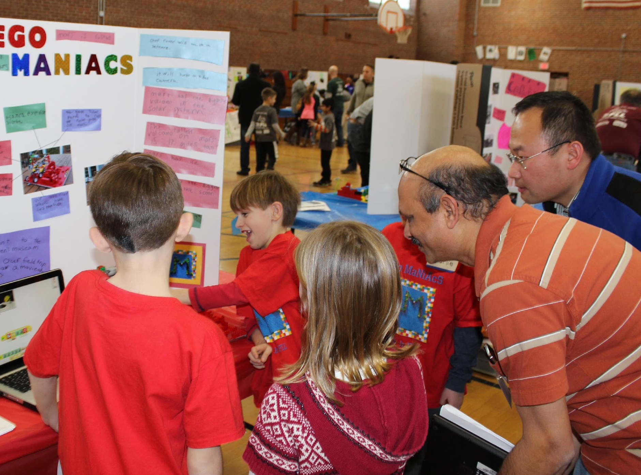
What is a Volunteer Reviewer?
Volunteer reviewers meet with teams and ask them questions about their season.
Help give awards at the closing ceremony

Slide 7
Volunteer Reviewer Responsibilities
2 Reviewers per team
Ask questions about their research, LEGO model and trifold display
Provide positive feedback to teams
Be kind and show interest in their project
Write down brief notes specific to each team to help with awards
Be part of the High-Five Line at the Closing Ceremony

Slide 8
Volunteer Reviewer Advice
“Don’t be mean, just say nice things no matter how it looks. They all tried and that’s good enough.” – Martha, age 10
“Ask about everything, even a blob of LEGO in the corner of the model. Someone built that for a reason. Try to get them all to talk about something.” – Luke, age 12

Slide 9
High-Five Ceremony
Teams are called up one at a time to receive their award. They go through a high-five line consisting of volunteers, reviewers and mentors
before returning to their seats.

Slide 10
THANK YOU, and…
…whatever you do, have fun!

